Slide 1
addlevel

Slide 2

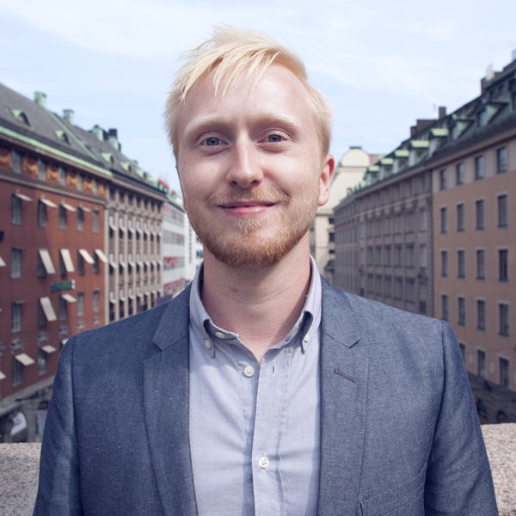
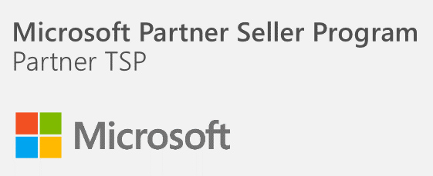

C:\> whoami
richard.ulfvin@addlevel.se
jonas.lagerstrom@addlevel.se
Microsoft P-TSP Cloud and Datacenter Management
Chief Technology Officer @Addlevel
Senior Consultant @Addlevel
http://www.addlevel.se

Slide 3
About this workshop
Audience
Level 400 – Advanced level
Course Prerequisites
Basic knowledge of Windows and Visual Studio
Course Objectives
Explain how Microsoft are incorporating Docker into their products
Explain why Containers is considered the future

Slide 4
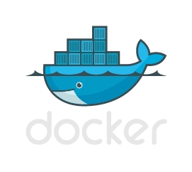

Introduction

Slide 5




What is the problem?
Manual configurations of servers
Dev -> Test -> Prod Builds
Initial documentation
Maintaining configurations
Documentation over time
Validating configuration during outages or breach
1
Plan
4
Monitor + Learn
2
Develop + Test
3
Release

Slide 6

What is a Container?
General
Let’s you slice up the OS to run multiple services on a single OS
Allows for a version set of dependencies (components, runtimes, etc.)
to run side by side with another set of dependencies
in an isolated runtime environment on the same machine
What makes that possible?
cgroups: limiting what you can use
namespaces: limiting what you can view
copy-on-write: storage tracks what's changed
Microservices and containers?
Microservices is an architectural design point; containers are an implementation detail that often helps.
Typically you run one application/service per container.

Slide 7

DEMO { container }

Slide 8
Container images
Container image size?
Keep them as small as possible
The “latest” tag
Does not mean you have the latest version
Refers to the latest image that has no tag/version associated with it
docker build -t addlevel/frontend .
Always version your container image!
docker build -t addlevel/frontend:1.0 .
Sign images using Docker notary

Slide 9

Constructing a container images
My Website
Container tied to dependencies
Base image
Added files, binaries, libraries
App platforms. Eg – MongoDB, apache, node.js, etc.
Configuration changes
Networking
Custom code
Can think of these as “layers”
One can build new layers on top of an existing container
Docker will pull these required dependencies to install/run
IIS

Slide 10
DEMO { versions }
Notes:
App-V1 / App-V2

Slide 11
DEMO { multi container applications }
Notes:
App-V1 / App-V2

Slide 12
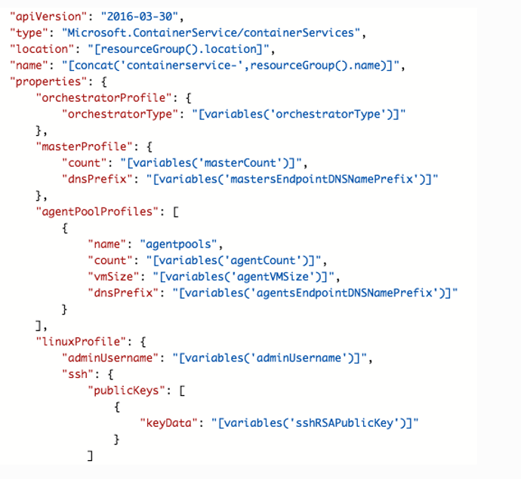
Docker and ACS
Templates for Azure

Slide 13
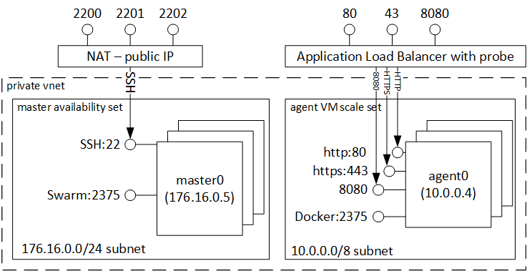
Docker Swarm Mode

Slide 14
DEMO { azure }
Notes:
App-V1 / App-V2

Slide 15

Continuous Integration and Deployments
Disclaimer: This is one way of doing it (although very common) and there are million
other ways and tools/services
Source Repo
CI
Docker Rep
Source Repo
CI
Docker Rep
Master
Master
Master
Master
Local Dev
Local Dev
D
D

Slide 16
DEMO { vsts }
Notes:
App-V1 / App-V2

Slide 17
Container Mangement in the Enterprise
Cluster deployment and management
Scheduling and automation
Service Discovery
Container Registry
Continuous deployment/ integration
Container placement and resource mgmt
Security
Monitoring and Logging

Slide 18

Apache Mesos / Marathon
Mesos
Open source cluster manager platform
Not just for containers (Hadoop, Spark, Elastic Search, etc.)
Scales to 10,000’s of nodes
Used by Twitter, AirBnB, Apple
Master/Slave with standby Masters (Zookeeper quorum)
Marathon
Framework for long running apps on Mesos clusters
Can be combined with other frameworks such as Chronos, Aurora, or Storm
One scheduler watching the other

Slide 19
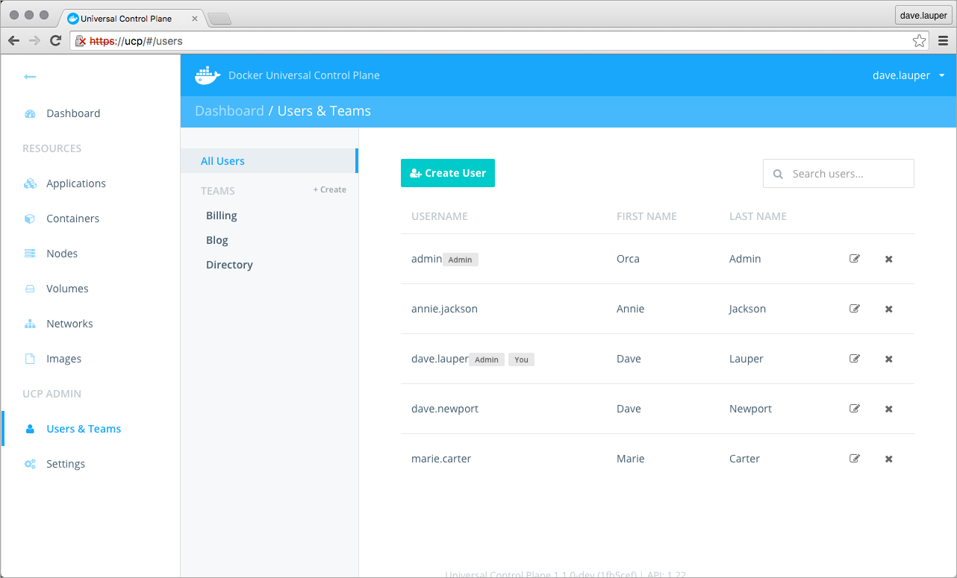
Docker Datacenter
Native Docker Engine
Docker Trusted Registry
Universal Control Plane

Slide 20
Takeaways
Environment automation
Everything in version control
Test configuration at deployment
Define different environments
“Stand-up a App-on-Stack on 100 nodes, and then enforce configurations”

Slide 21
End
www.addlevel.se

